Slide 1
Keyboard Jump Game
Using Python
(Minor Project)
Submitted To:-
Submitted By:-
Ms. Nandita Kohli
Junaid Qureshi
Adarsh Gangwar
Aayush Amoli

Slide 2
Project analysis slide 2
Components used
Modules and Components we are using in this project.
Python 3
Pygame Module
PROJECT
Random Module
Time Module
Background Image
Character Image

Slide 3
Project analysis slide 3
Modules Description
Pygame Module
Random Module
Time Module
……………………..………
………………..……………
………………………….
The Pygame library is an open-source module for the Python programming language specifically to help you make games and other multimedia applications.
Python Random module is an in-built module of Python which is used to generate random numbers or values.
It allows us to handle various operations regarding time, its conversions and representations, which find its use in various applications in life.

Slide 4
Project analysis slide 4
About The Game
Keyboard jump game is a speed typing game that helps in improving the typing speed of players.
The object of Keyboard Jump Game Python Project is to build a keyboard jump game that helps players to increase their typing speed. We use pygame, random, and time modules in this project.
In this project, the player has to press the same keys to the letters displayed on the game screen. If the player made an error while typing then the game gets over.

Slide 5
Functioning of Project
pygame.init() initialize pygame.
pygame.display.set_caption will set the caption of the game window.
WIDTH and HEIGHT are setting game display size by using pygame.display.set_mode.
game background set by pygame.image.load, which is used to set the background image.
pygame.transform.scale is used to scale image to required dimensions.

Slide 6
Functioning of Project
new_word() function will randomly take words from word.txt file
game_front_screen() function display the front game screen and game over screen.
pygame.event.get() will return all the event stored in the pygame event queue.
event.KEYUP event occurs when a keyboard key is pressed and released.

Slide 7
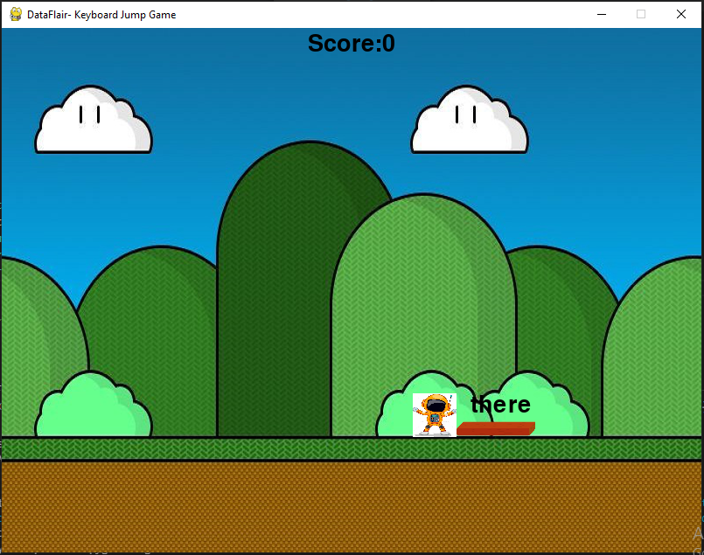
Project analysis slide 7
Interface

Slide 8
Thank You

